Slide 1
Parking management system w/ nfc access
Ems project by BUCUR Bogdan, Demian Daria & Știube bogdan – Group: 30421

Slide 2

Project description
The purpose of the project is to implement on a lower scale a parking management system with NFC access. It makes use of multiple sensors and actuators such as: servo motors, infrared sensors, two-digit seven-segment-display and an NFC module. Each of them will be presented individually further down the line.
Functioning mode: when a car is detected at the entrance of the parking lot by the IR sensor it will also wait for a NFC input to open the barrier (turn on the servos). The barrier will stay up for a time, until it will come back down. After the car entered, the number on the seven segment display increases by 1. When a car is detected at the exit by the IR sensor, the barrier will open and will stay so for a limited time. After the car left the parking lot, the value on the SSD decreases by 1. When the parking lot is considered full, the barrier on the entrance will no longer open until someone exists.

Slide 3
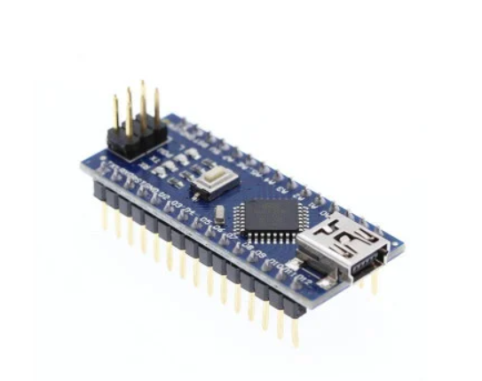

Hardware used
Arduino Nano (Bootleg): this is the microcontroller we use to command all our system since it is easy to work with and program. We make use of the digital I/O and analog I pins as well the I2C communication protocol capability.
Some board specs:
Microcontroller: ATmega328p
Functioning Voltage: 5V
Digital I/O pins: 14
Analog INPUT pins: 8
Flash Memory: 32 kB
Clock Speed: 16 MHz

Slide 4

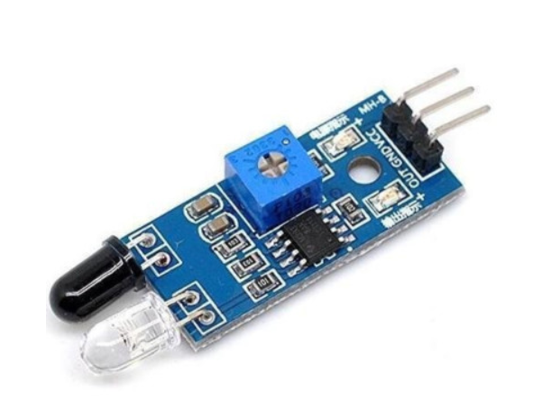
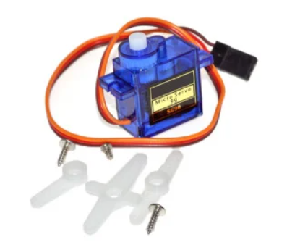
HARDWARE USED
INFRARED SENSORS
SERVOMOTORS
This is used to detect the car at the entrance or exit of the parking lot. It works by “shooting” a beam of light the from the emitter that bounces of the surface of the object back to the sensor’s receiver thus detecting the object. Its sensitivity can be modified by adjusting the integrated potentiometer.
It can detect up to 20cm in distance and an angle of 35 degrees.
Two of these servos are used in the system: one at the entry of the parking and one at the exit. They move the barrier up or down, depending on the input signal. The model we use can rotate 360 degrees and are continuous. To bypass this issue we give a value to the motor to go in a direction, a value at which it stops and another to change the direction going back to the initial position. Instead of telling the motor at which angle it must go we tell it the direction and time it shall rotate.

Slide 5
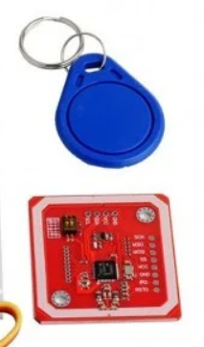
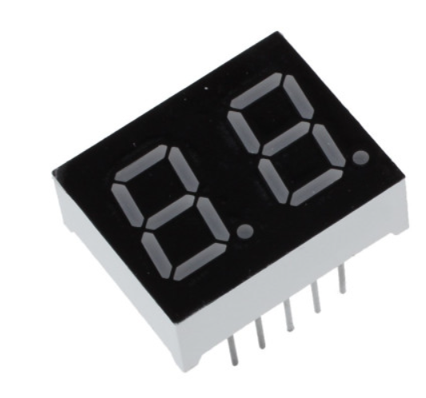
HARDWARE USED
2 DIGIT SSD
PN532 NFC MODULE
This is the display we use to show the number of cars in the parking lot a time. The maximum number of cars in the parking lot is the same as the maximum number that the SSD can display: 99.
The NFC module works by detecting changes in its magnetic field crated by the magnetic field of a NFC tag, which induces an electric current used for communication. It communicates with the controller through I2C protocol.
It can detect up to 7 cm.

Slide 6
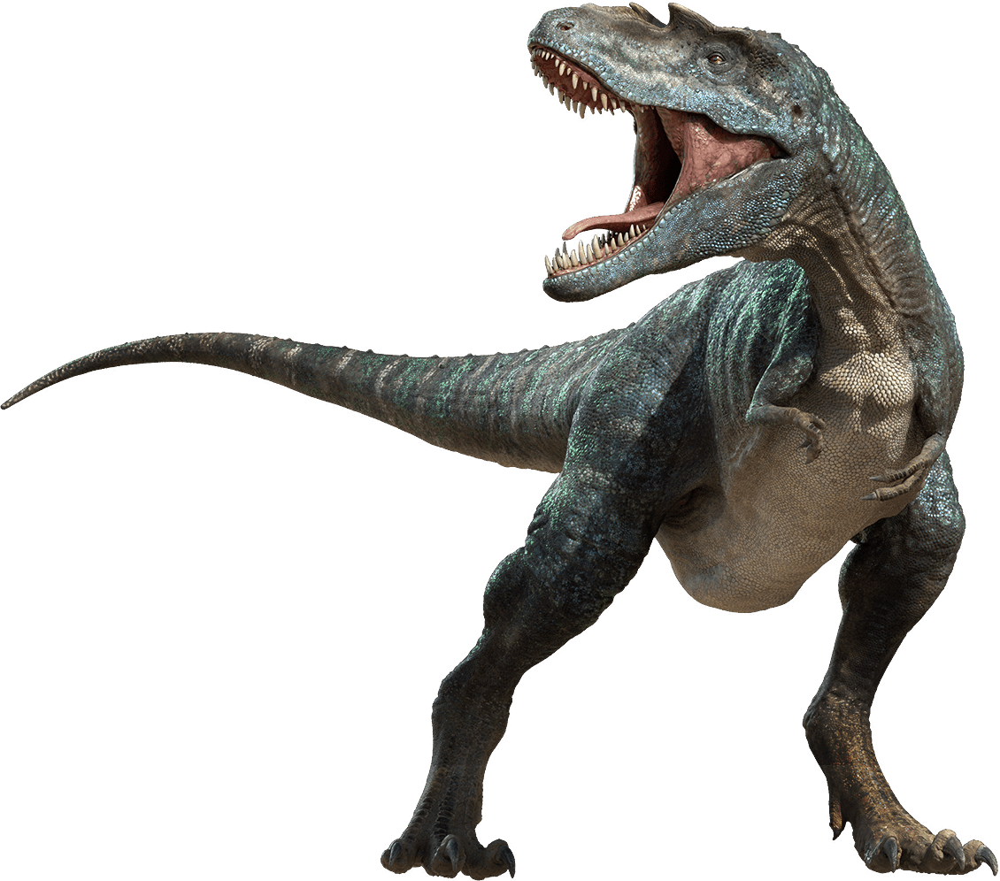

SOFTWARE USED
The software tool used for programming the microcontroller is Arduino IDE which uses the C++ programming language

Slide 7

Code
void setup() {
Serial.begin(115200);
pinMode(LED_BUILTIN,OUTPUT); //nfc
pinMode(IR1_PIN, INPUT);
SME.attach(SME_PIN);
pinMode(IR2_PIN, INPUT);
SMX.attach(SMX_PIN);
nfc.begin();
digitalWrite(LED_BUILTIN, LOW); //nfc
for (int i = 2; i < 9; i++) //ssd
{
pinMode(i, OUTPUT);
}
pinMode(12, OUTPUT); //declare 7 seg Digit1 pin as output
pinMode(11, OUTPUT); //declare 7 seg Digit2 pin as output
}
void readNFC() {
static unsigned long lastRead = 0;
if (millis() - lastRead < 300) return;
if (nfc.tagPresent()) {
NfcTag tag = nfc.read();
tagId = tag.getUidString();
lastRead = millis();
}
}
void dis(int num)
{
for (int i = 2; i < 9; i++)
{
digitalWrite(i, bitRead(digit[num], i - 2));
}
}
SETUP FUNCTION
HELPER FUNCTIONS

Slide 8

Code
int stateIR1 = digitalRead(IR1_PIN); // LOW->object ; HIGH->NO object
int stateIR2 = digitalRead(IR2_PIN);
readNFC();
// NFC -------------------------------------------------------------
if (tagId == tagId1 || tagId == tagId2) {
digitalWrite(LED_BUILTIN, !digitalRead(LED_BUILTIN));
tagId = "";
}
// DISPLAY CAR COUNT -----------------------------------------------
digitalWrite(11, HIGH);
digitalWrite(12, LOW);
dis(carCount/10);
delay(10);
digitalWrite(12, HIGH);
digitalWrite(11, LOW);
dis(carCount%10);
delay(10);
// B1 operation ----------------------------------------------------
if( !FULL and !BE and !FULL and nfc.tagPresent() and stateIR1 == LOW ){ //
SME.write(120);
delay(850);
SME.write(100);
BE=1;
}
if( BE and lastStateIR1 == LOW and stateIR1 == HIGH){
delay(400);
SME.write(70);
delay(800);
SME.write(100);
if(empty) empty=0;
carCount++;
if(carCount >= carCapacity) FULL=1;
BE=0;
}
MAIN LOOP FUNCTION

Slide 9

Code
// B2 operation ----------------------------------------------------
if( !empty and !BX and lastStateIR2 == HIGH and stateIR2 == LOW){
SMX.write(120);
delay(800);
SMX.write(100);
BX=1;
}
if( !empty and BX and lastStateIR2 == LOW and stateIR2 == HIGH){
delay(400);
SMX.write(70);
delay(800);
SMX.write(100);
if(FULL) FULL=0;
carCount--;
if(carCount==0) empty=1;
BX=0;
}
lastStateIR1=stateIR1;
lastStateIR2=stateIR2;
}
MAIN LOOP FUNCTION

Slide 10


Thank you for your kind attention!
EMS Project by Bucur Bogdan, Demian Daria & Știube Bogdan – Group: 30421

